Slide 1
Clinician Wellness Summit:
How do we support our clinicians being able to care for their patients?
November 1, 2019

Slide 2

Negative forces pressing on physicians
Lack of autonomy/work control
Quantity and pace of work
Excessive documentation
Excessive time pressure
Regulatory burdens
Arduous hunt for clinical information via EHR design
Lack of actionable data
Professional liability
Expanding knowledge base with insufficient tools
Insufficient staffing
Inadequate reimbursement
Conflicting payment models
Burdensome quality reporting
Negative on-line reviews
Prior authorization

Slide 3
Burnout: Signs of Improvement
Source: Shanafelt T, West CP, Sinsky C, et al. Changes in Burnout and Satisfaction With Work-Life Integration in Physicians and the General US Working Population between 2011-2017. Mayo Clin Proc In press.

Slide 4
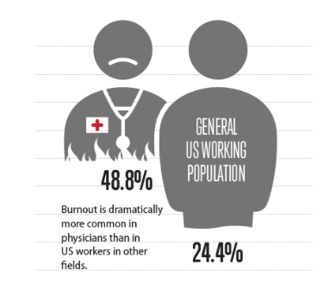
How Do Physicians Compare?
39.8%
28.1%
Source: Shanafelt T, West CP, Sinsky C, et al. Changes in Burnout and Satisfaction With Work-Life Integration in Physicians and the General US Working Population between 2011-2017. Mayo Clin Proc In press.

Slide 5
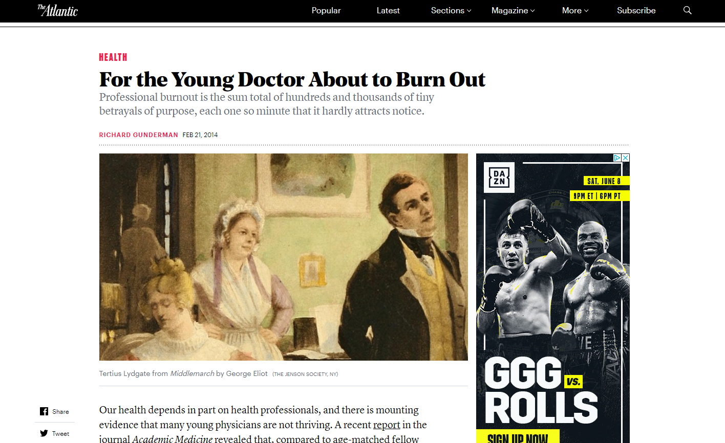
Why Burnout?
“Burnout at its deepest level is not the result of some train wreck of examinations, long call shifts, or poor clinical evaluations. It is the sum total of hundreds and thousands of tiny betrayals of purpose, each one so minute that it hardly attracts notice.”
Richard Gunderman
The Atlantic
February 21, 2014

Slide 6

What Causes Dissatisfaction?
“Burnout was associated with high stress, low work control, and low values alignment with leaders ”
Linzer M, Poplau S, Babbott S, et al. Worklife and wellness in academic general internal Medicine: Results from a national survey. J Gen Intern Med. 2016.
“The leadership qualities of physician supervisors appear to impact the well-being and satisfaction of individual physicians.”
Shanafelt TD, Gorringe G, Menaker R, et al. Impact of organizational leadership on
physician burnout and satisfaction. Mayo Clin Proc. 2015;90:432-40.
“The number of hours a physician works is not
related to happiness, but the perceived ability to
manage workload was significantly related
to happiness.”
Eckleberry-Hunt J, Kirkpatrick H, Taku K, et al. Relation Between Physicians' Work
Lives and Happiness. South Med J. 2016 Apr;109(4):207-12.

Slide 7
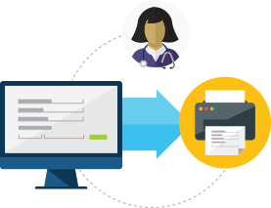
What Causes Dissatisfaction?
“Physicians who used EHRs and CPOE were less satisfied with the amount of time spent on clerical tasks and were at higher risk for professional burnout.”
Shanafelt TD, Dyrbye LN, Sinsky C, et al. Relationship between clerical burden and characteristics of the electronic environment with physician burnout and professional satisfaction. Mayo Clin Proc. 2016.
“More after-hours time spent on the EHR was associated with burnout and less work-life satisfaction.”
  Robertson SL, Robinson MD, Reid A. Electronic Health Record Effects on Work-Life Balance and Burnout Within the I3 Population Collaborative. J Grad Med Educ. 2017 Aug;9(4):479-484.
  “Physicians who reported higher % of time spent on administrative duties had lower levels of career satisfaction, higher levels of burnout, and were more likely to be considering seeing fewer patients.”
  Rao SK, Kimball AB, Lehrhoff SR, et al. The Impact of Administrative Burden on Academic Physicians: Results of a Hospital-Wide Physician Survey. Acad Med. 2017 Feb;92(2):237-243.

Slide 8
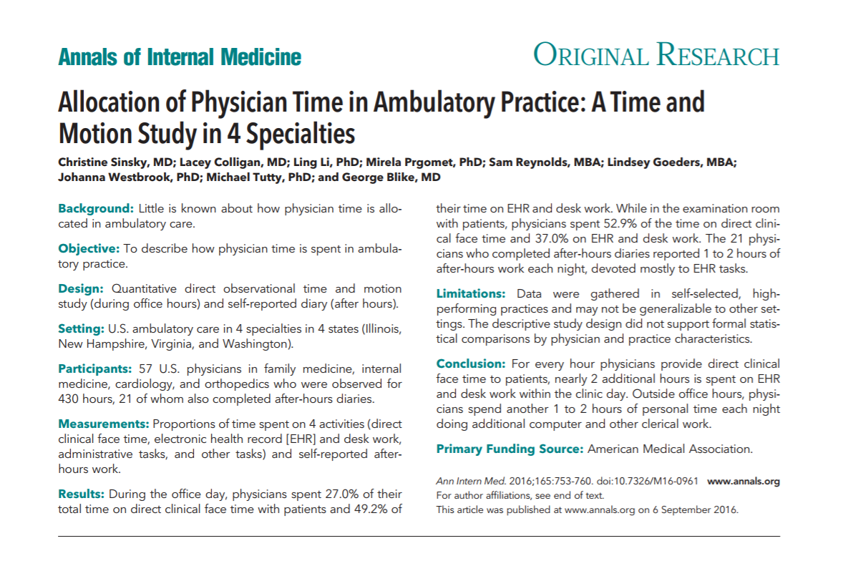
Allocation of Physician Time: Part 1
For every hour of physicians clinical face time to patients, nearly 2 additional hours are spent on EHR/desk work.
Outside office hours, physicians spend another 1 to 2 hours each night doing EHR/desk work.

Slide 9
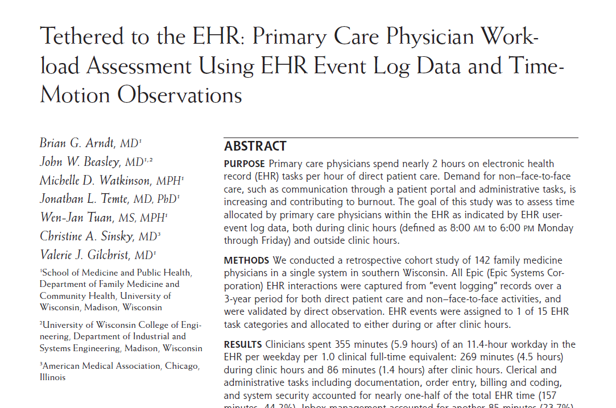
Allocation of Physician Time: Part 2
Physicians spent an average of 5.9 hours out of an 11.4-hour workday working in the EHR.
Clerical and administrative tasks accounted for 44 percent of the total EHR usage time
Brian G. Arndt, John W. Beasley, Michelle D. Watkinson, Jonathan L. Temte, Wen-Jan Tuan, Christine A. Sinsky, and Valerie J. Gilchrist, Tethered to the EHR: Primary Care Physician Workload Assessment Using EHR Event Log Data and Time-Motion Observations, Ann Fam Med September/October 2017 15:419-426

Slide 10
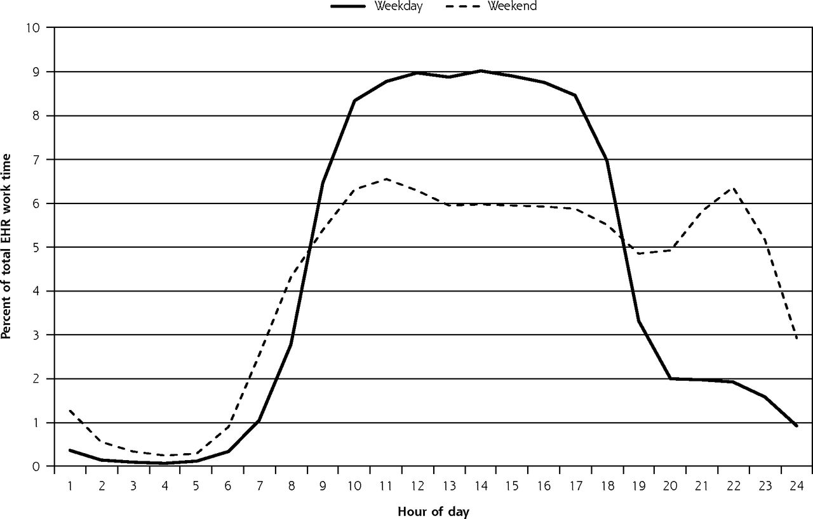
“Pajama Time”: Saturday nights belong to EHRs
142 FM
3 yr
Date night
Week nights
Brian G. Arndt, John W. Beasley, Michelle D. Watkinson, Jonathan L. Temte, Wen-Jan Tuan, Christine A. Sinsky, and Valerie J. Gilchrist, Tethered to the EHR: Primary Care Physician Workload Assessment Using EHR Event Log Data and Time-Motion Observations, Ann Fam Med September/October 2017 15:419-426

Slide 11
Summary of Burnout Drivers
Burnout is driven by:
high workloads
workflow inefficiencies
increased time spent with documentation/administration
loss of meaning in work
social isolation at work
misalignment of values
Burnout has repercussions at a personal and professional level

Slide 12

Why Does Burnout Matter?
“We found support for the notion that the depersonalization dimension of physician burnout was associated with patient outcomes of lower satisfaction and longer post discharge recovery time (after controlling for severity of illness and other demographic factors).”
Halbesleben JR, Rathert C. Linking physician burnout and patient outcomes: Exploring the dyadic relationship between physicians and patients. Health Care Manage R. 2008;33:29-39
“Physician burnout, fatigue, and work unit safety grades were independently associated with major medical errors.”
Tawfik D, Profit J, Morgenthaler T, Satele D, Sinsky C, Dyrbye L, Tutty M, West CP, Shanafelt T, Physician Burnout, Well-being, and Work Unit Safety Grades in Relationship to Reported Medical Errors, Mayo Clinic Proceedings, Volume 93, Issue 11, 2018.

Slide 13
Three More Studies: Patient Outcome Implications
“…Dense EHR communication patterns not supplemented by dense face-to-face interactions were associated with less effectively controlled cholesterol levels and more emergency department visits for the team’s patient panels.”
Marlon P. Mundt, Valerie J. Gilchrist, Michael F. Fleming, Larissa I. Zakletskaia, Wen-Jan Tuan, and John W. Beasley. Effects of Primary Care Team Social Networks on Quality of Care and Costs for Patients With Cardiovascular Disease. Ann Fam Med March/April 2015 13:139-148; doi:10.1370/afm.1754
“Patients preferred and perceived the F2F [face-to-face] physician as more compassionate and professional and as having better communication skills (compared to those who use an examination room computer)”
Haider A, Tanco K, Epner M, et al. Physicians’ Compassion, Communication Skills, and Professionalism With and Without Physicians’ Use of an Examination Room Computer: A Randomized Clinical Trial. JAMA Oncol.2018;4(6):879–881. doi:10.1001/jamaoncol.2018.0343
“Clinicians on the high‐use [of EHR] ICUs experienced “silo” effects with potential safety and quality implications…Situational awareness, communication, and patient satisfaction were negatively affected by this siloing.”
Leslie, M. , Paradis, E. , Gropper, M. A., Kitto, S. , Reeves, S. and Pronovost, P. (2017), An Ethnographic Study of Health Information Technology Use in Three Intensive Care Units. Health Serv Res, 52: 1330-1348. doi:10.1111/1475-6773.12466

Slide 14
Physicians Leaving Practice and Profession Due to Burnout
1
5
Physicians intend to reduce clinical work hours in the next year
Because of Burnout
1
50
Physicians intend to leave medicine altogether in the next 2 years to pursue a different career.
Source: Sinsky, Christine A. et al., Professional Satisfaction and the Career Plans of US Physicians,
Mayo Clinic Proceedings , Volume 92 , Issue 11 , 1625 - 1635

Slide 15
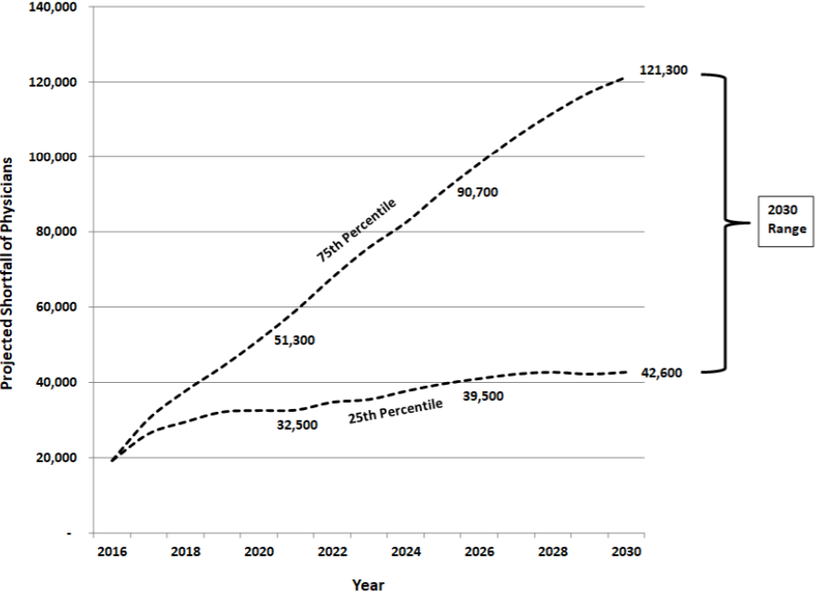
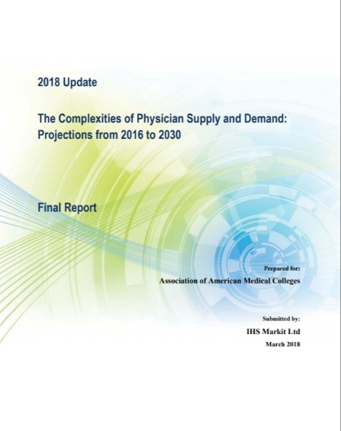
Projected physician shortfall of between 42,600 and 121,300
Source: 2018 Update - The Complexities of Physician Supply and Demand: Projections from 2016 to 2030 - Final Report, Association of American Medical Colleges

Slide 16
Physician burnout is a symptom of system dysfunction

Slide 17
How do we change?
Awareness
Commitment

Slide 18
“It's not that I'm so smart, it's just that I stay with problems longer.”
- Albert Einstein

Slide 19
How do we support our physicians being able to care for their patients?
US Health System
Organizational
Individual
Environmental

Slide 20
“We always hope for the easy fix: the one simple change that will erase a problem in a stroke. But few things in life work this way. Instead, success requires making a hundred small steps go right - one after the other, no slipups, no goofs, everyone pitching in.”
- Atul Gawande, Better: A Surgeon's Notes on Performance

Slide 21
For the Individual

Slide 22
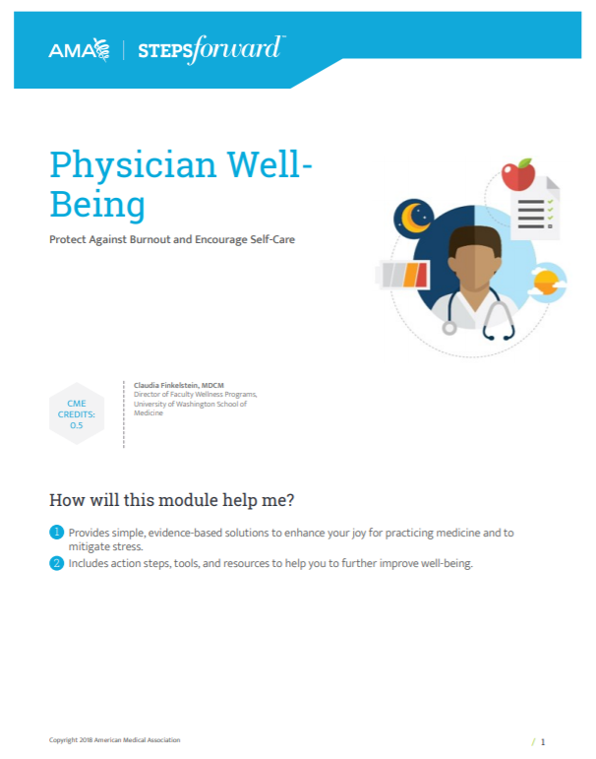
STEP 1: Take a deep breath and get organized
1
Put yourself on your own schedule
2
Take stock of your desires, feelings and actions that may be contributing to stress or burnout
3
Identify and prioritize your values and compare them to how you spend your time
4
Source: STEPS Forward “Physician Well-Being: Protect Against Burnout and Encourage Self-Care” https://edhub.ama-assn.org/steps-forward/module/2702556

Slide 23
STEP 2: Think about your practice or training from a different perspective
4
Write your individual mission statement
5
Write down inspiring patient stories
Source: STEPS Forward “Physician Well-Being: Protect Against Burnout and Encourage Self-Care” https://edhub.ama-assn.org/steps-forward/module/2702556

Slide 24
STEP 3: Think about the big picture
6
Consider the legacy you want to leave behind
7
Start a gratitude journal
8
Learn to manage your time and finances
9
Develop your spiritual practice
Source: STEPS Forward “Physician Well-Being: Protect Against Burnout and Encourage Self-Care” https://edhub.ama-assn.org/steps-forward/module/2702556

Slide 25
STEP 4: Find support and guidance in outside groups
9
Consider a support group
10
Enlist your peers to provide support
11
Seek professional help
12
Connect with local resources
Source: STEPS Forward “Physician Well-Being: Protect Against Burnout and Encourage Self-Care” https://edhub.ama-assn.org/steps-forward/module/2702556

Slide 26
STEP 5: Find meaning outside of work
13
Volunteer
14
Don’t forget to have fun!
Learn something new
15
Take a mindfulness class
16
Connect with your body
Source: STEPS Forward “Physician Well-Being: Protect Against Burnout and Encourage Self-Care” https://edhub.ama-assn.org/steps-forward/module/2702556

Slide 27
For the Organization

Slide 28

Evidence: organizational changes have bigger impact
  “Twenty independent comparisons from 19 studies were included in the meta-analysis...
  …This finding provides support for the view that burnout is a problem of the whole health care organization, rather than individuals.”
Panagioti M, Panagopoulou E, Bower P, et al. Controlled Interventions to Reduce Burnout in Physicians: A Systematic Review and Meta-analysis. JAMA Intern Med. 2017 Feb 1;177(2):195-205.

Slide 29
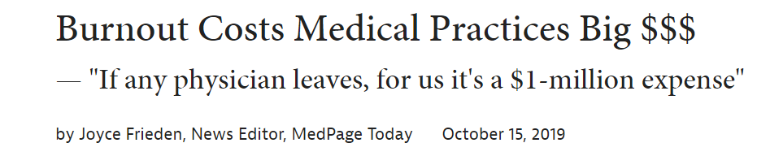
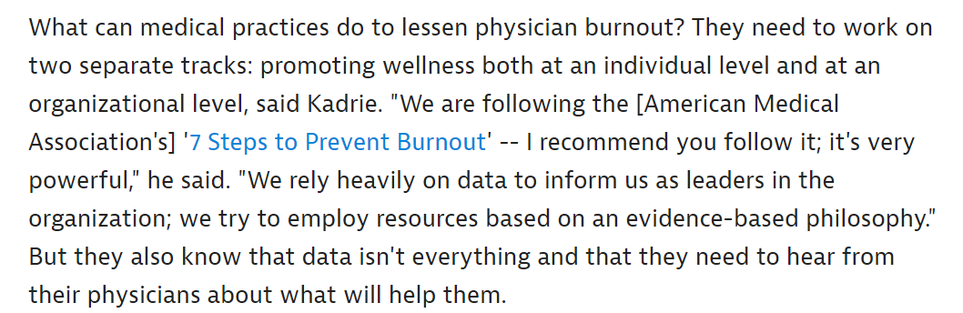
Seven steps to prevent burnout in your practice
1) Establish wellness as a quality indicator for your practice
2) Start a wellness committee and/or choose a wellness champion
3) Distribute an annual wellness survey
4) Meet regularly with leaders and/or staff to discuss data and interventions to promote wellness
5) Initiate selected interventions
6) Repeat the survey within the year to re-evaluate wellness
7) Seek answers within the data, refine the interventions and continue to make improvements
Steps Forward Physician Burnout Improve Physician Satisfaction and Patient Outcomes
https://edhub.ama-assn.org/steps-forward/module/2702509

Slide 30
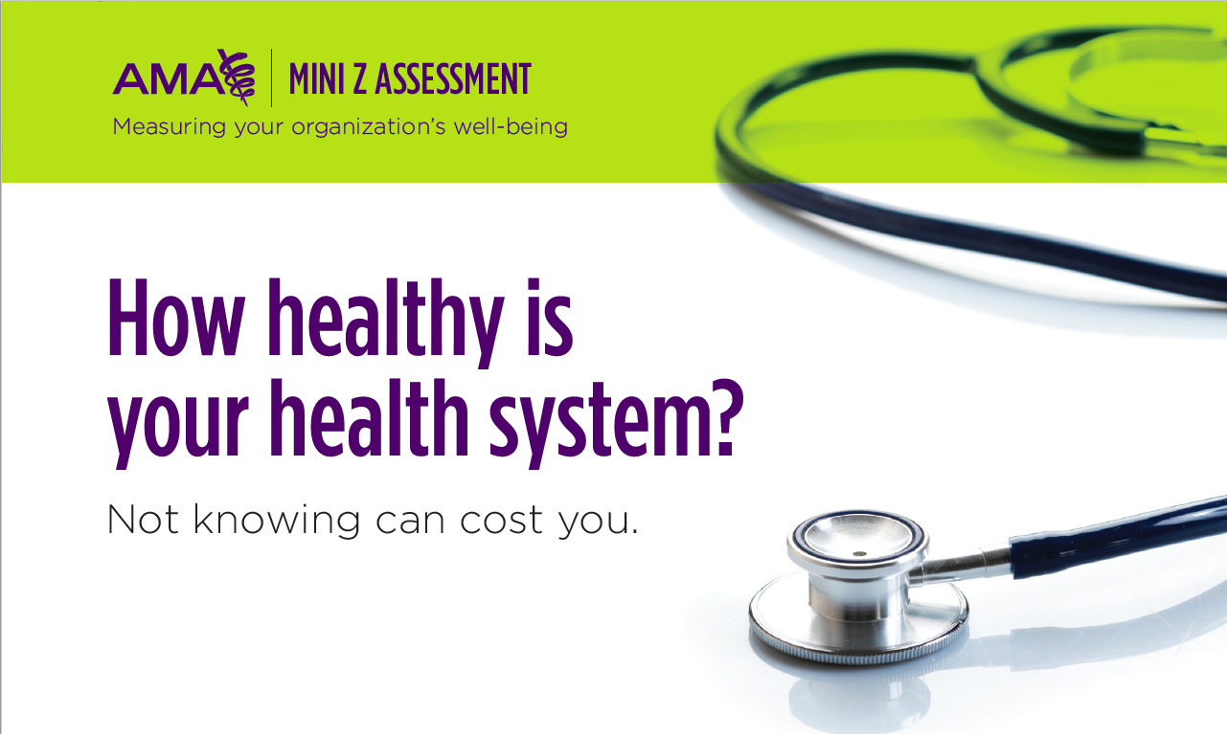

Slide 31

Practice Changes
“Organizations may be able to improve burnout,
dissatisfaction and retention by addressing
communication and workflow, and initiating
QI projects targeting clinician concerns.”
Linzer M, Poplau S, Grossman E, et al. A cluster randomized trial of interventions
to improve work conditions and clinician burnout in primary care: Results from the
Healthy Work Place (HWP) Study. J Gen Intern Med. 2015;30:1105-11.
“…A shift from a physician-centric model of work distribution and responsibility to a shared-care model, with a higher level of clinical support staff per physician and frequent forums for communication, can result in high-functioning teams, improved professional satisfaction, and greater joy in practice.”
Sinsky CA, Willard-Grace R, Schutzbank AM, Sinsky TA, Margolius D, Bodenheimer T. In search of joy in practice: A report of 23 high-functioning primary care practices. Ann Fam Med. 2013;11:272-8.

Slide 32

Transform Your Practice to Save 3-5 hours/day
Practice Re-engineering
Pre-visit lab ½ hour
Prescription management ½ hour
Expanded rooming/discharge 1 hour
Optimize physical space 1 hour
Team documentation 1-2 hours
3+ hours/day

Slide 33
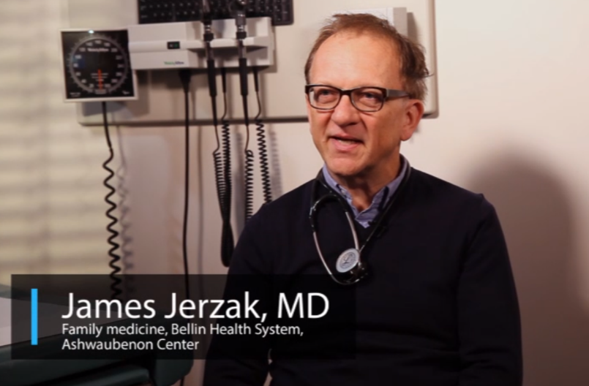
Team-based Documentation
“Adding personnel to perform more administrative components of office practice was associated with less pre- and post-session physician time… and higher patient satisfaction.”
Reuben DB, Knudsen J, Senelick W, Glazier E, Koretz BK. The Effect of a Physician Partner Program on Physician Efficiency and Patient Satisfaction. JAMA internal medicine. 2014;174(7):1190-1193. doi:10.1001/jamainternmed.2014.1315.
“I never document at home, everything is done and closed by the time I leave the office.”
“…a new model of care delivery with an enhanced role for medical assistants during the office visit increased physician-patient face-to-face time.”
Misra-Hebert, Anita D. et al., A Team-based Model of Primary Care Delivery and Physician-patient Interaction, The American Journal of Medicine , Volume 128 , Issue 9 , 1025 - 1028

Slide 34

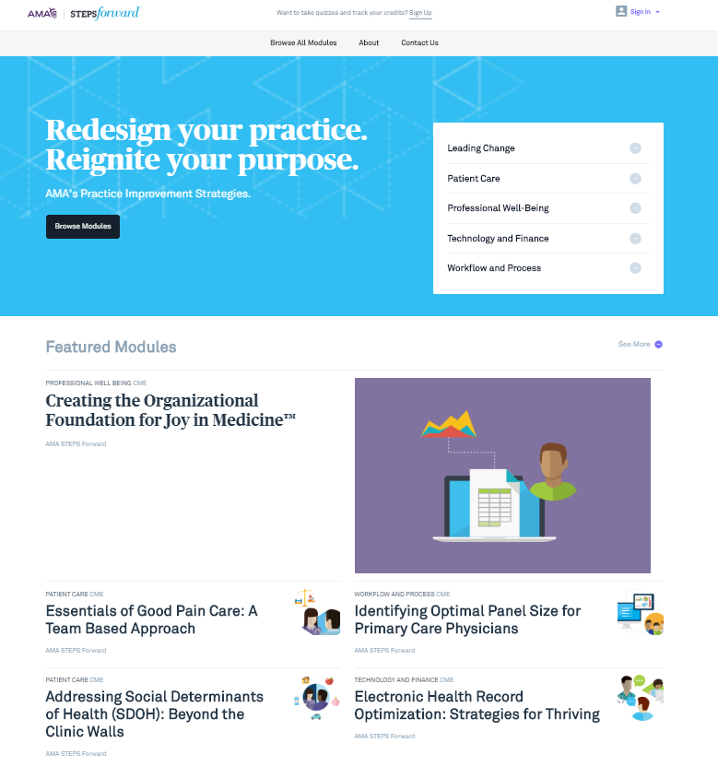
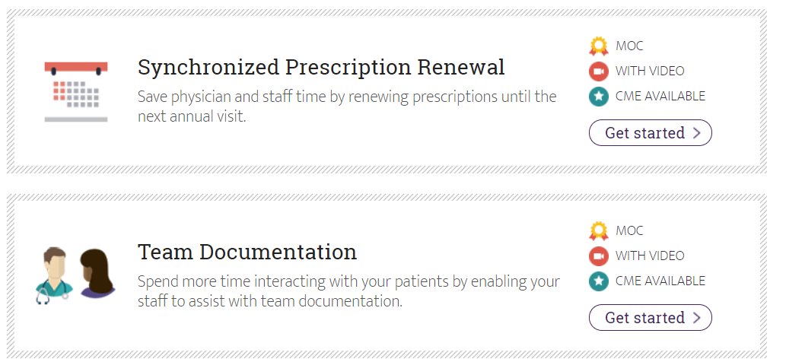
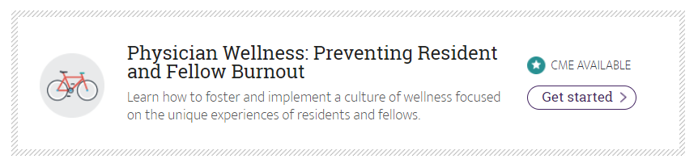
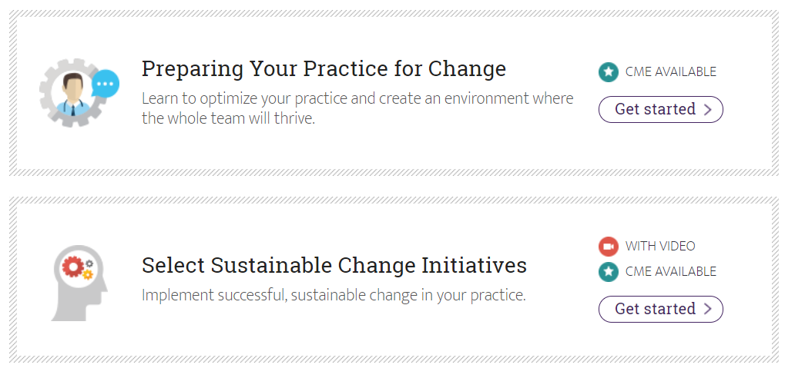
One Solution to Returning Joy to Practice
www.stepsforward.org

Slide 35
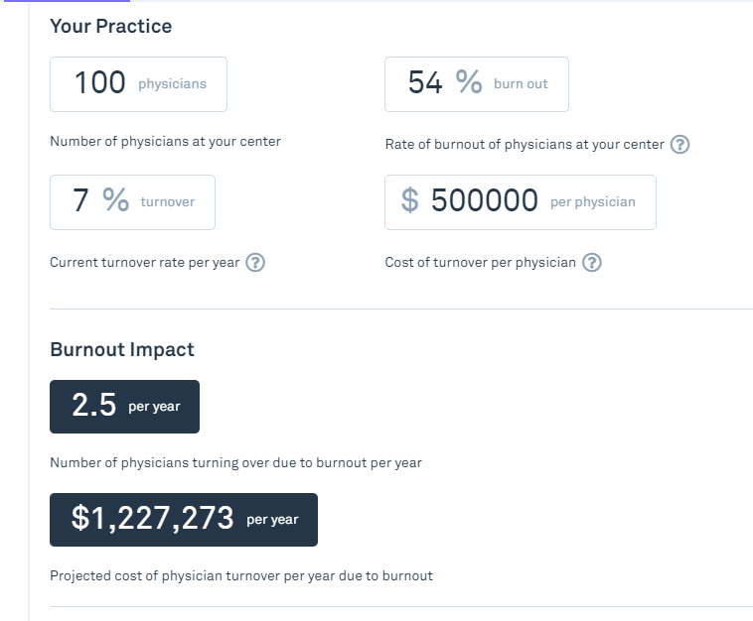
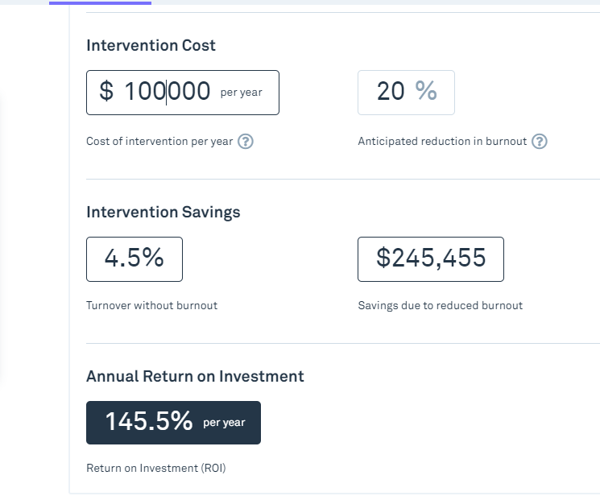
Impact Calculators
Burnout Impact Calculator
Intervention ROI Calculator

Slide 36

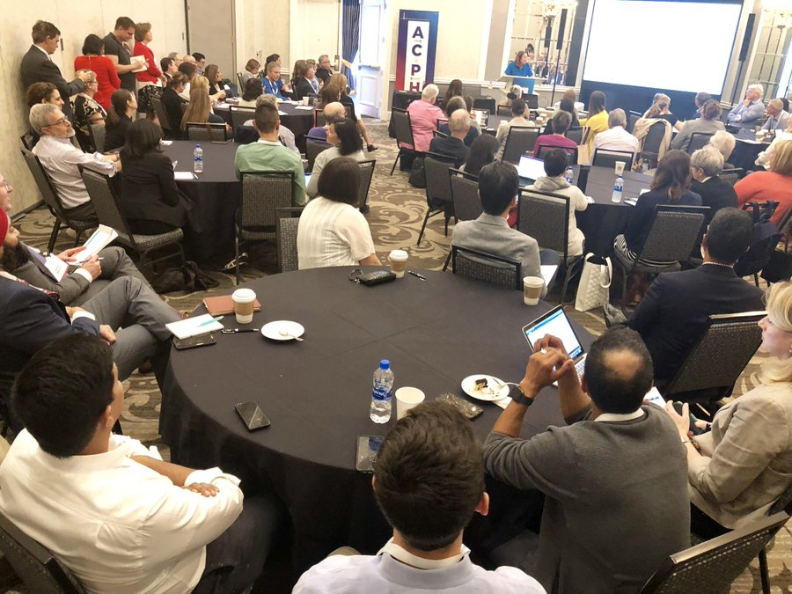

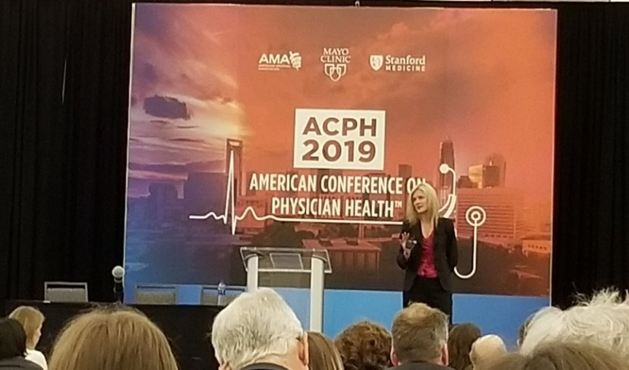
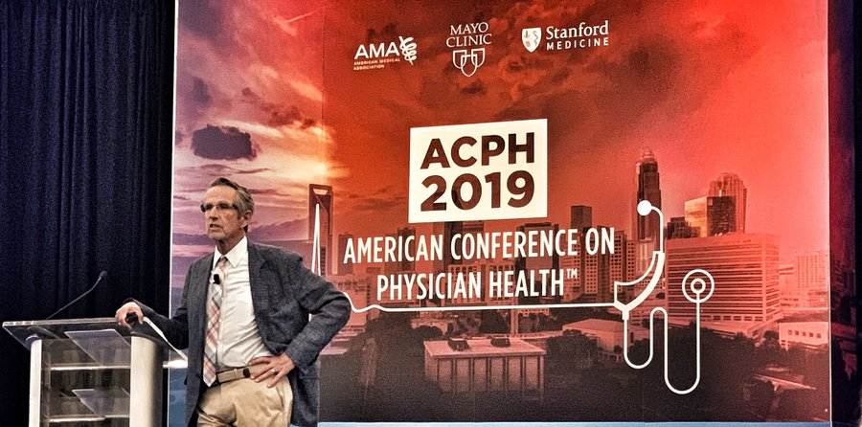
Conferences on Physician Health
American Conference on Physician Health
(Odd Years)
September 19-21, 2019 – Charlotte
International Conference on Physician Health
(Even Years)
September 14-16, 2020 - London
450+ Attendance

Slide 37
More Research Needed on Organization Solutions
SOLUTIONS
IMPACT / CONSEQUENCES
CAUSE
FREQUENCY / PREVALANCE
RESEARCH TRAJECTORY

Slide 38
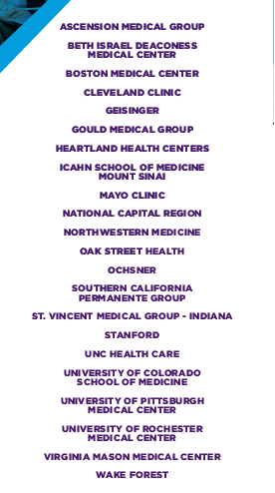

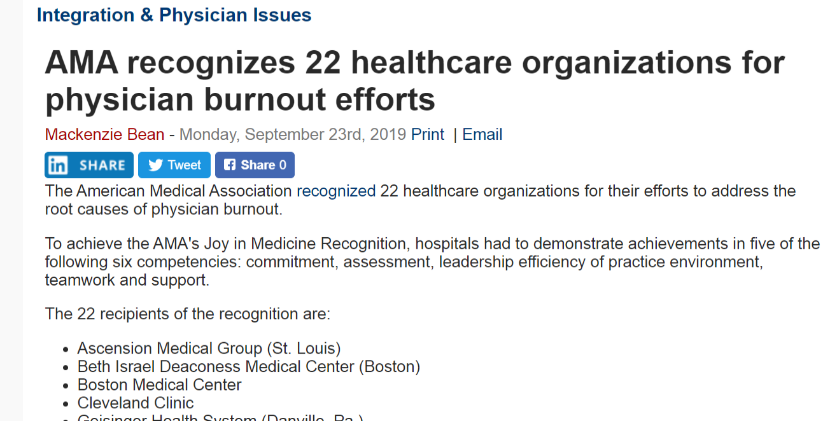
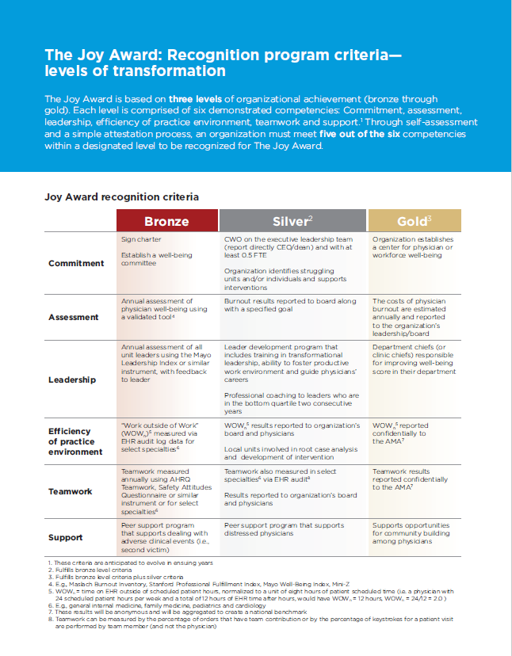

Joy in Medicine Recognition Program
Attended In-Person
Mayo Clinic
Southern California Permanente Group
Beth Israel Deaconess Medical Center
DOD, National Capital Region
Stanford Health Care

Slide 39
“A critic looking at these tightly focused, targeted interventions might dismiss them as Band-Aid solutions. But that phrase should not be considered a term of disparagement. The Band-Aid is an inexpensive, convenient, and remarkably versatile solution to an astonishing array of problems.”
Malcolm Gladwell, The Tipping Point: How Little Things Can Make a Big Difference

Slide 40
For the US Health System

Slide 41
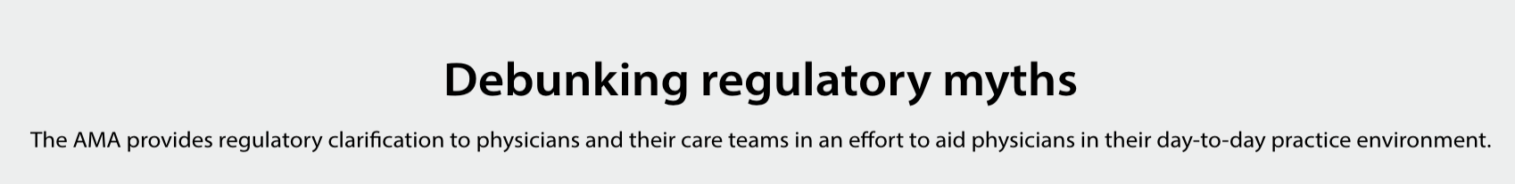

Debunking Regulatory Myths

Slide 42
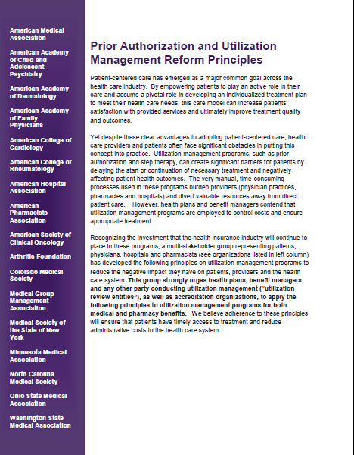

AMA Prior Authorization Survey
A strong majority (88% and 86%) of physicians report that the number of PAs required for prescription medications and medical services has increased over the last five years
Almost seven in 10 (69%) physicians report that it is difficult to determine whether a prescription or medical service requires PA
An overwhelming majority (85%) of physicians report that PA interferes with continuity of care
100+ additional stakeholders have signed on in support
AMA survey of 1,000 physicians in December 2018

Slide 43
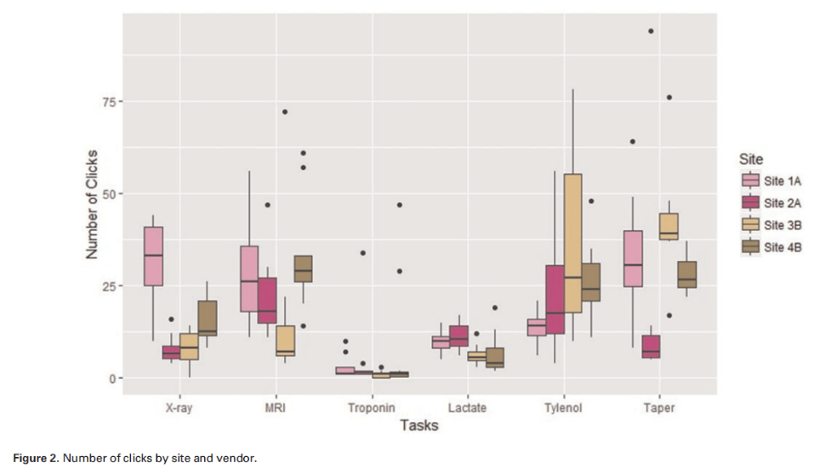
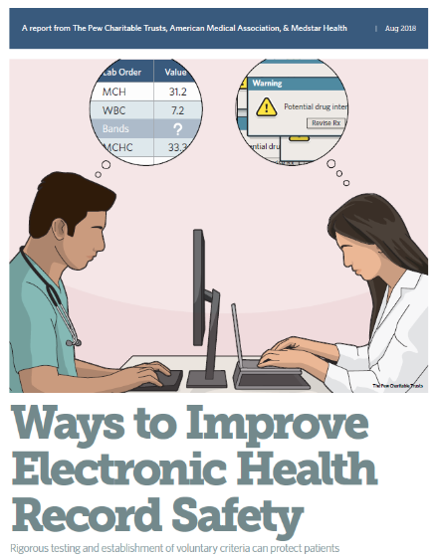
AMA EHR Efforts
EHR Usability Study
Voluntary Certification Tenets and Test Cases
Looked at types of errors and rates, number of clicks and total time spent performing common EHR tasks
Significant variation across vendors and between sites
EHR Voluntary Framework with Test Cases
Pew Charitable Trusts, AMA, & Medstar Health

Slide 44

New Technologies Driven By Medical Science
Wave of New Technologies
Software
  Predictive analytics
  Big data
  Artificial Intelligence
Hardware
  Sensors
  Cameras
  Battery life
  3D printing
Infrastructure
  Wireless
  Broadband

Slide 45


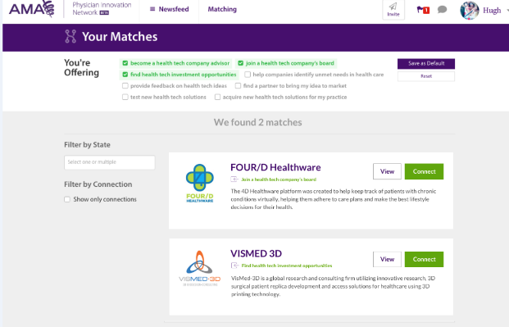


Influencing the Development of New Healthcare Digital Technologies
Industry: Xcertia
Innovation: Health 2047
Product Development:
Physician Innovation Network
Practice Support:
Digital Health Playbook
Interoperability: IHMI

Slide 46
“There is good evidence to suggest that membership and engagement in professional societies…is an important step toward overcoming physician burnout.”
A sense of belonging and community can mitigate physician burnout Bulletin of the American College of Surgeons, August 1, 2019.

Slide 47
Identifying Opportunities in Vermont
Health System in Vermont
Organizational
Individual
Environmental

Slide 48
Contact Information
Michael Tutty, PhD, MHA
Group Vice President – Professional Satisfaction and Practice Sustainability
American Medical Association
AMA Plaza
330 North Wabash Avenue, Suite 39300
Chicago IL 60611-5885
P: (312) 464-4158
M: (312) 513-8810
michael.tutty@ama-assn.org

